Slide 1



INDRAPRASTHA INSTITUTE OF INFORMATION TECHNOLOGY
Detection of Abusive Comments
- Presented by Ranit Pal

Slide 2

I
INTRODUCTION
The use of social media and micro-blogging sites has increased immensely over time.
It has become one of the significant sources of information and a way to express individuals' views.
As the use has increased, the necessity to impose required filtration and checks over the comments and posts has also increased.
To overcome this, we have proposed an ML-based approach to detect whether a comment is abusive.
Dataset used: "Hated speech and offensive language dataset" [1].
The dataset consists of comments from Twitter and contains abusive, non-abusive, and hate speech comments.
2

Slide 3
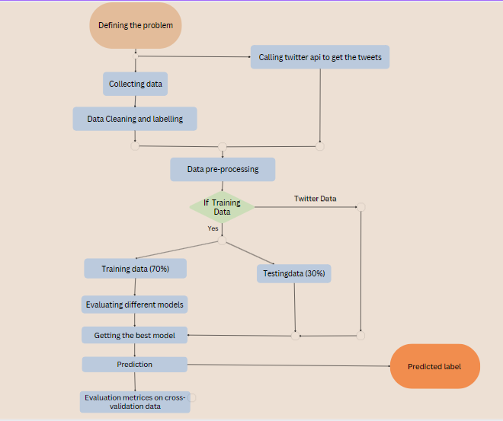
III
METHODOLOGY
Pre-processing
Basic cleaning
Lemmatize
Tokenization
Stopwords
Non-English words
Classifiers used
Naïve Bayes
Support Vector Machine
Logistic Regression
Decision Tree
Random Forest
2
FIG. 1 FRAMEWORK OF THE MODEL.

Slide 4
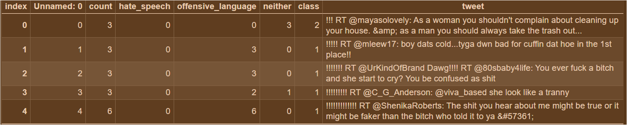

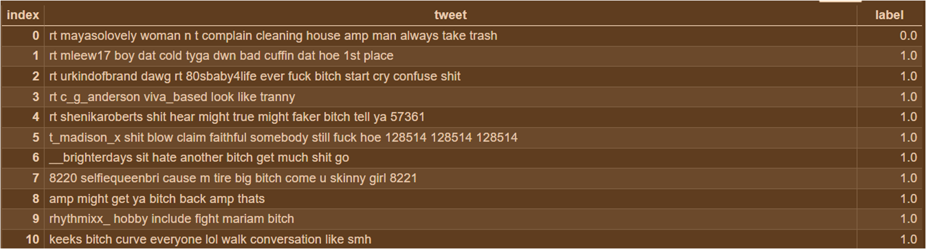
Raw Data
FIG 2. UNPROCESSED INITIAL DATA.
Processed Data
2
Fig 3. Processed data.

Slide 5
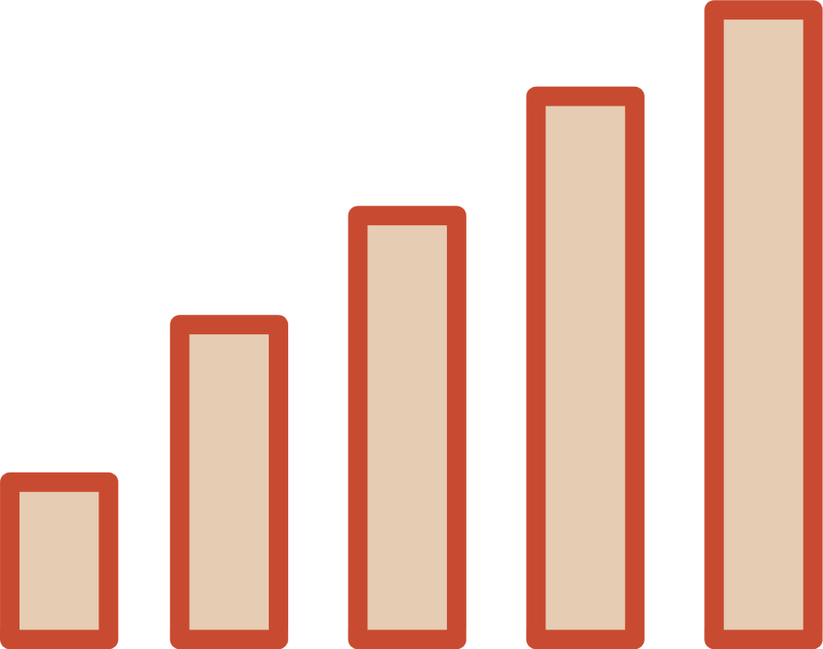
IV
RESULT AND DISCUSSION
CLASSIFIER | ACCURACY (%) | PRECISION (%) | RECALL (%) | F1-SCORE (%)
Logistic Regression | 96.04 | 98.11 | 97.03 | 97.58
Support Vector Machine | 96.21 | 98.52 | 96.82 | 97.66
Decision Tree | 82.14 | 82.18 | 99.79 | 90.13S
Random Forest | 81.74 | 81.74 | 1.00 | 89.95
Naïve Bayes | 90.75 | 90.80 | 98.67 | 94.57
Voting Classifier | 96.16 | 97.82 | 97.46 | 97.64
2
Table 1. Comparative analysis of classifiers based on accuracy, precision, recall, F1-score.

Slide 6

CLASSIFIER | TP | TN | FP | FN | ACCURACY (%)
Logistic Regression | 1172 | 5557 | 107 | 170 | 96.04
Support Vector Machine | 1196 | 5545 | 83 | 182 | 96.21
Decision Tree | 40 | 5715 | 1239 | 12 | 82.14
Random Forest | 0 | 5727 | 1279 | 0 | 81.74
Naïve Bayes | 707 | 5651 | 572 | 76 | 90.75
Voting Classifier | 1155 | 5582 | 124 | 145 | 96.16
Table 2. Comparative analysis of different classifiers based on TP, TN, FP, FN and accuracy.
2

Slide 7
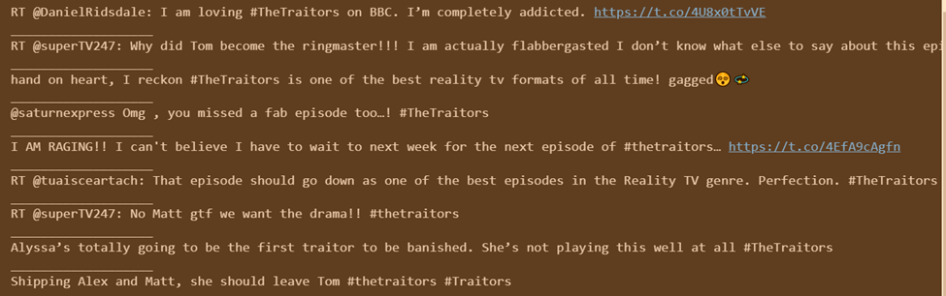

Sample tweets using Twitter API
Fig 5. Sample comments.

Slide 8

V
CONCLUSION
In this project, we have proposed a machine learning based approach for detecting if the comment is of abusive nature or not. Our approach is capable enough of identifying the comments based on its nature into the suitable class with a very high F1-score.
We have procured An F1-score of 97.58% using Logistic Regression, 97.66% using SVM, using Decision Tree, 89.95% using Random Forest, 94.57% using Naïve Bayes and 97.64% using Voting Classifier.
We can see that the accuracies of Decision Tree and Random Forest are although high (>80%) but still both are not a good classifiers for this dataset as they both are having the problem of accuracy paradox.
2

Slide 9
INDRAPRASTHA INSTITUTE OF INFORMATION TECHNOLOGY
Thank you
for listening!

